Slide 1
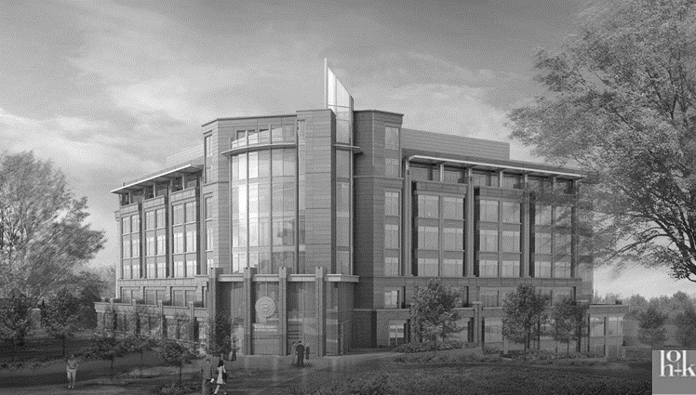
Senior Thesis Presentation
Bucks County Justice Center
Doylestown, PA
Joshua Lange
Lighting/Electrical
Thesis Adviser: Dr. Richard Mistrick
Electrical Adviser: Gary Golaszewski
4/15/2015

Slide 2
Introduction
Presentation Overview
Location/Site
Building Overview
Lighting Depth
Electrical Depth
Mechanical Breadth
Acoustical Breadth and MAE Depth
Conclusion
Project Introduction
Lighting Depth
Electrical Depth
Mechanical Breadth
Acoustical Breadth/MAE Depth

Slide 3
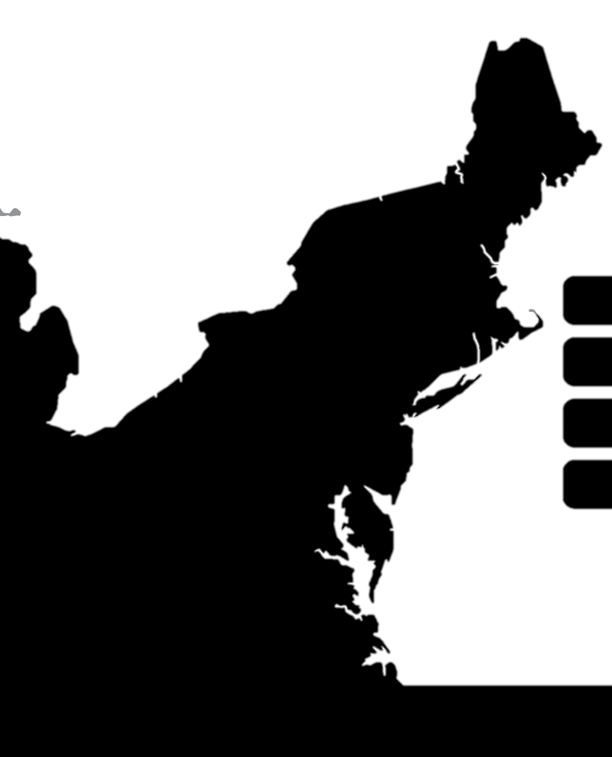
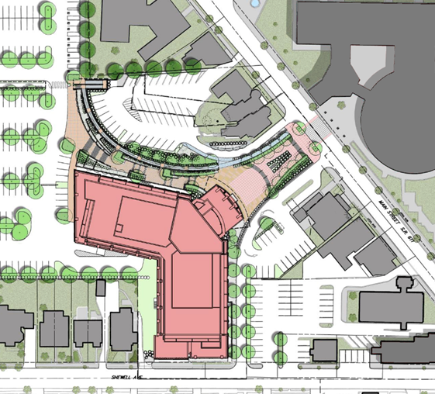

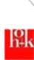
Introduction
Presentation Overview
Location/Site
Building Overview
Lighting Depth
Electrical Depth
Mechanical Breadth
Acoustical Breadth and MAE Depth
Conclusion
Bucks County Justice Center
Doylestown, PA

Slide 4
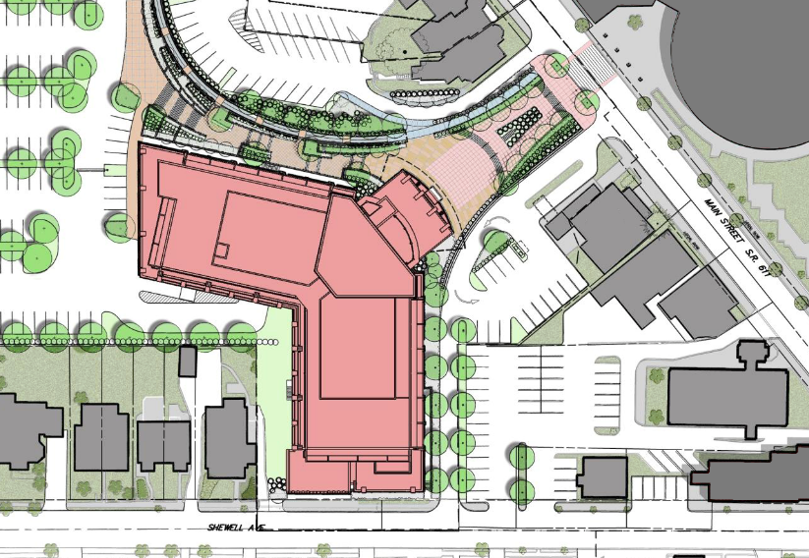
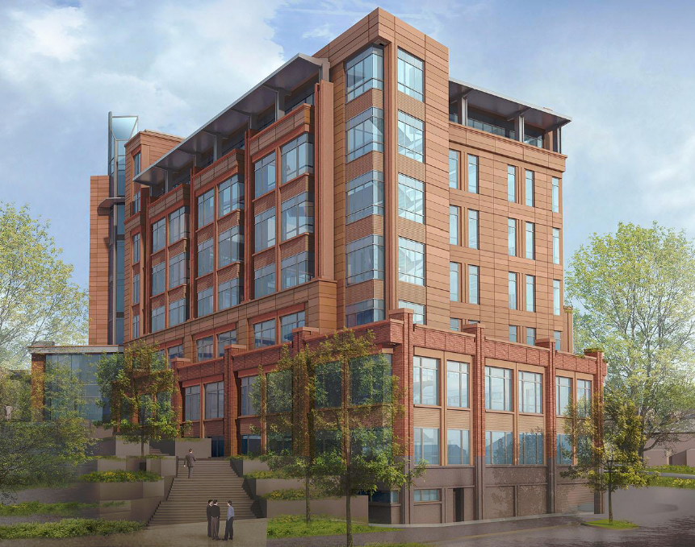


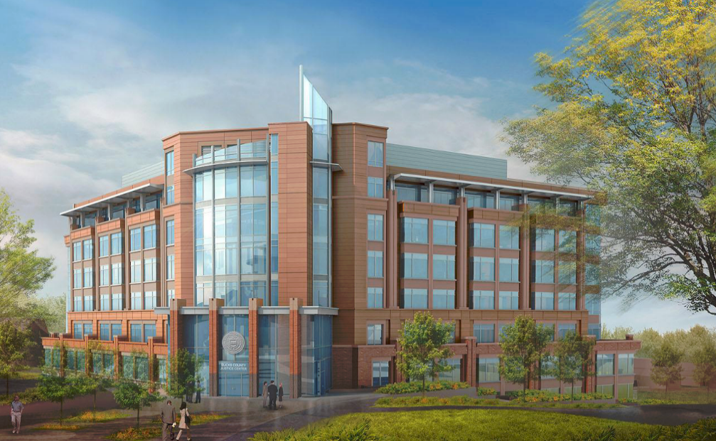
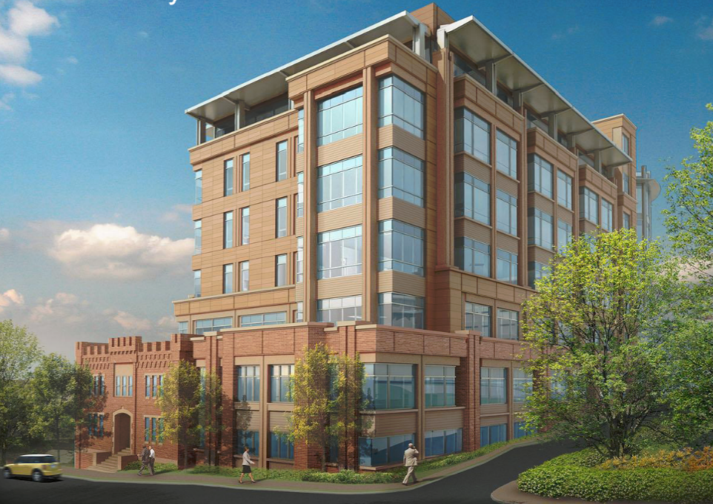
Introduction
Presentation Overview
Location/Site
Building Overview
Lighting Depth
Electrical Depth
Mechanical Breadth
Acoustical Breadth and MAE Depth
Conclusion
Existing Administration Building
1.
1
2
3
2.
3.

Slide 5
Introduction
Presentation Overview
Location/Site
Building Overview
Lighting Depth
Electrical Depth
Mechanical Breadth
Acoustical Breadth and MAE Depth
Conclusion
Existing Administration Building
1.
1
Building Statistics
Size: 273,000 GSF
Levels: 7 above grade (with penthouse)
2 below grade
Dates of construction: July 2011-February 2015
Overall Project Cost: approximately $84 million
2
3
2.
3.

Slide 6
Introduction
Presentation Overview
Location/Site
Building Overview
Lighting Depth
Electrical Depth
Mechanical Breadth
Acoustical Breadth and MAE Depth
Conclusion
Existing Administration Building
1.
1
Project Team
Architect: HOK
MEP: H. F. Lenz
Lighting: Tigue Lighting
Telecom, Data, A/V, and Acoustics: Acentech Incorporated
Civil Engineering: Carroll Engineering Corporation
Structural: The Harman Group
Security and Code Consulting: Brinjac Engineers
General Contractor: Ernest Bock & Sons, Inc.
2
3
2.
3.

Slide 7
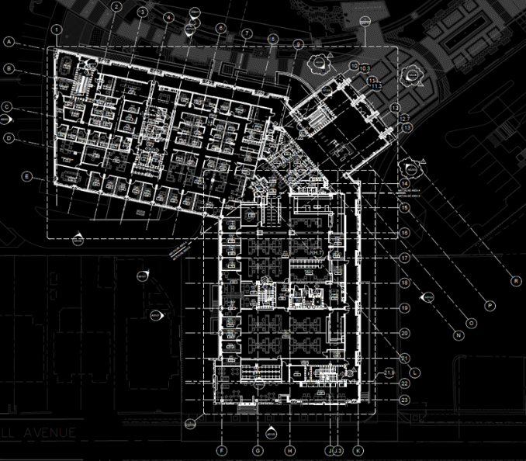
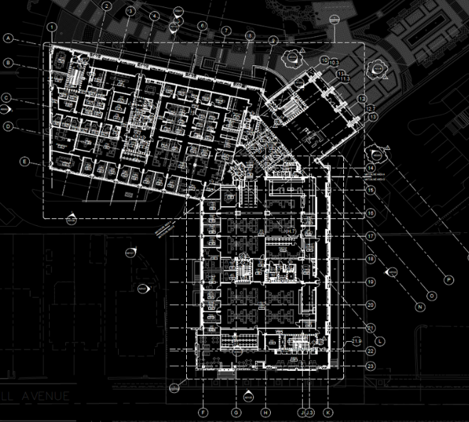
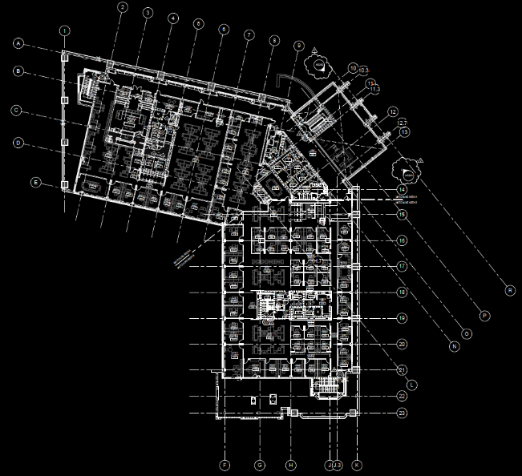
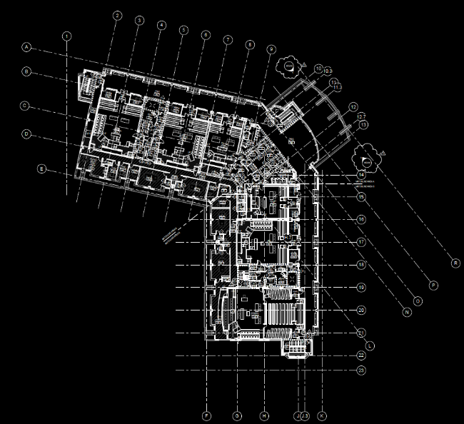
Introduction
Lighting Depth
Main Lobby
Open Office
Ceremonial Courtroom
Electrical Depth
Mechanical Breadth
Acoustical Breadth and MAE Depth
Conclusion
Spaces
Outdoor Space: Main Plaza
Circulation Space: Main Lobby 1000
Design Criteria
Qualitative
Professional
Consistency
Quantitative
CRI:80
CCT: 3500K
Target of 20% reduction from ASHRAE maximum LPD
N
N
Large Workspace: Open Office 2520
Special Purpose Space: Ceremonial Courtroom 4100
N
N

Slide 8

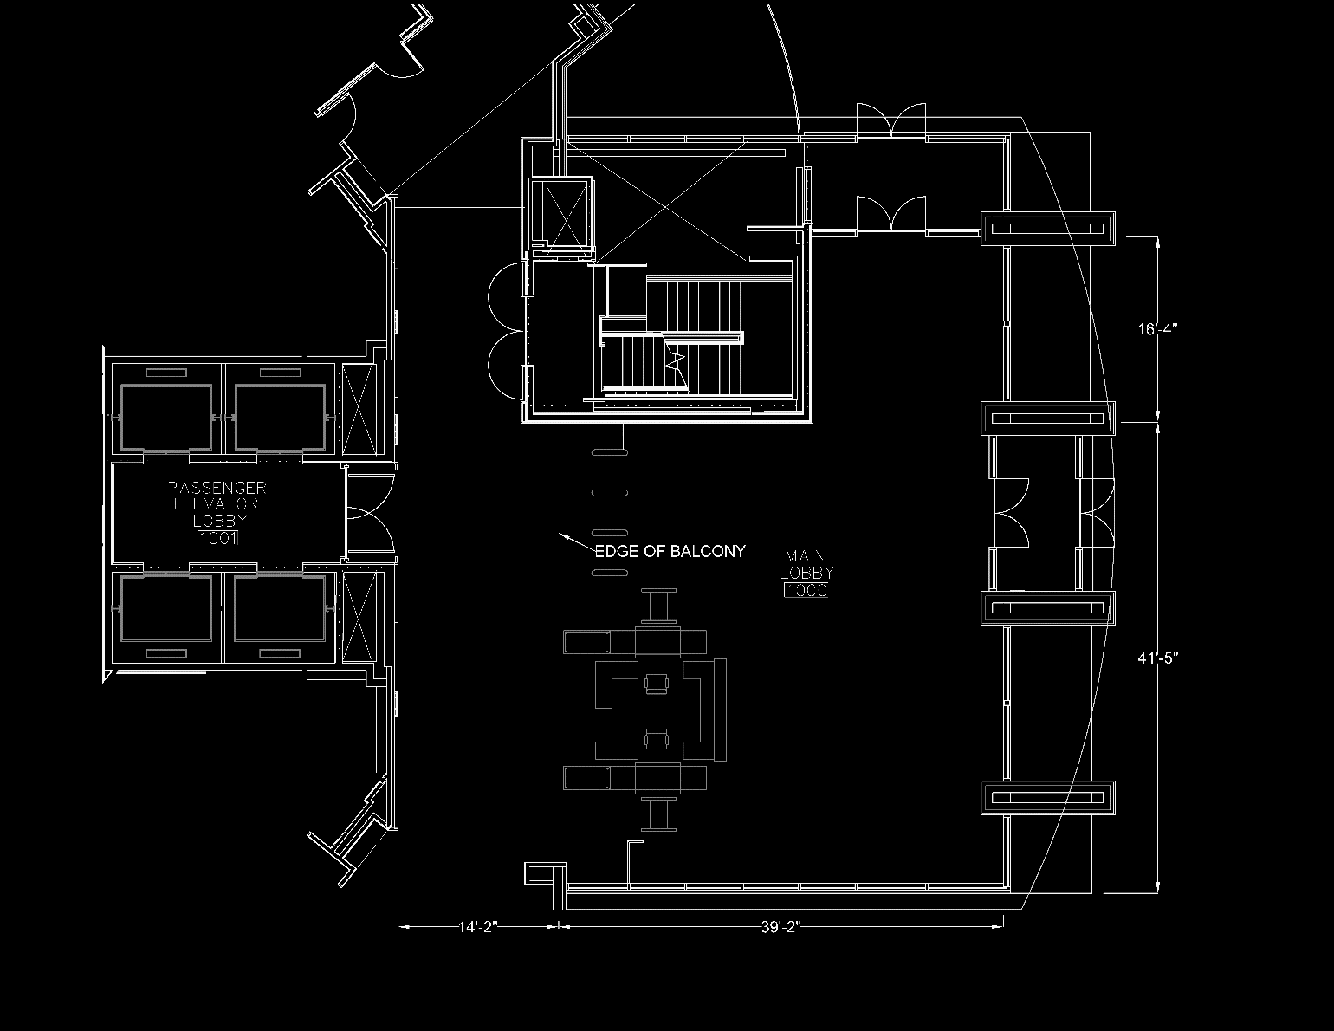
Introduction
Lighting Depth
Main Lobby
Introduction/Location
Design Criteria
Final Design
Design Analysis
Open Office
Ceremonial Courtroom
Electrical Depth
Mechanical Breadth
Acoustical Breadth and MAE Depth
Conclusion
Main Lobby 1000
N
N

Slide 9
Introduction
Lighting Depth
Main Lobby
Introduction/Location
Design Criteria
Final Design
Design Analysis
Open Office
Ceremonial Courtroom
Electrical Depth
Mechanical Breadth
Acoustical Breadth and MAE Depth
Conclusion
Main Lobby 1000
Room Area: ~3,000 SF
Ceiling Height: 28’-0”
Balcony
N

Slide 10
Introduction
Lighting Depth
Main Lobby
Introduction/Location
Design Criteria
Final Design
Design Analysis
Open Office
Ceremonial Courtroom
Electrical Depth
Mechanical Breadth
Acoustical Breadth and MAE Depth
Conclusion
Quantitative Criteria
Qualitative Criteria
Assist Security screening
Spacious and grand
Way finding
Location | Eh (lux) | Elevation Eh | Avg:Min
Security Screening | 200 | 3’-0” | 2:1
Lobbies near entries (day) | 100 | Floor | 4:1
LPD (W/SF) | Local Control | Automatic Daylight Responsive Controls for Sidelighting | Automatic Full OFF | Scheduled Shutoff
0.9 | REQ | REQ | ADD2 | ADD2

Slide 11
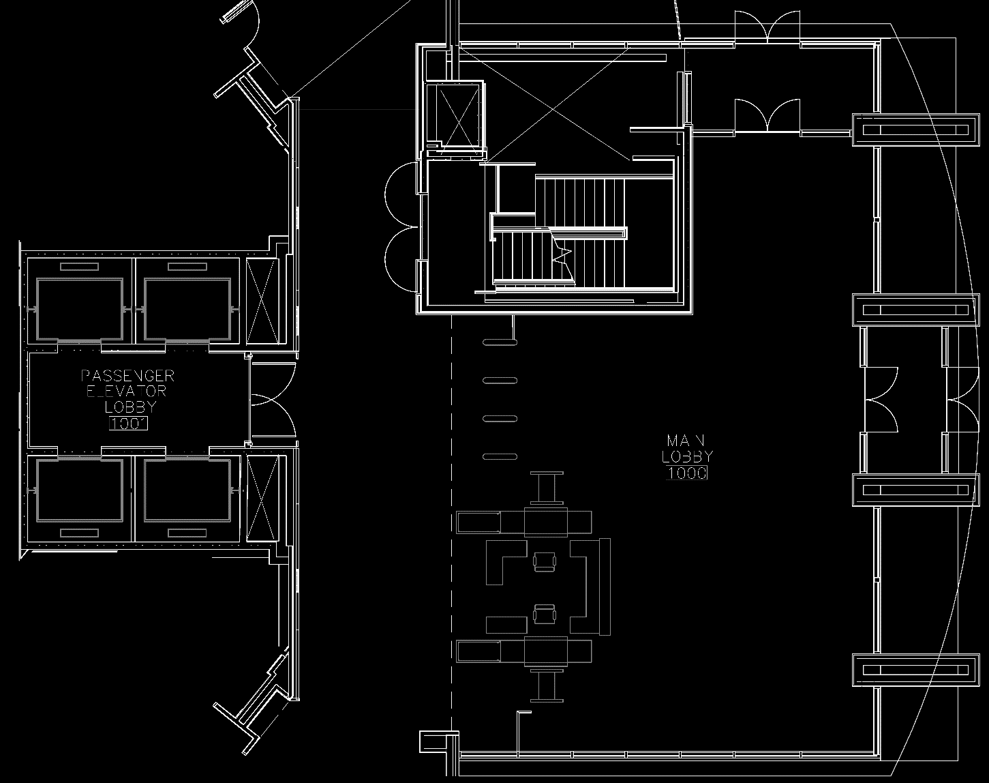
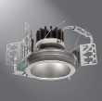
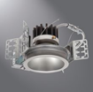
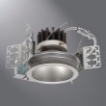
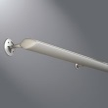
Introduction
Lighting Depth
Main Lobby
Introduction/Location
Design Criteria
Final Design
Design Analysis
Open Office
Ceremonial Courtroom
Electrical Depth
Mechanical Breadth
Acoustical Breadth and MAE Depth
Conclusion
Type | Description | CCT (K) | CRI | Life (Hours) | Input (Watts) | Fixture Image
R3 | RECESSED CIRCULAR 6 INCH WIDE BEAM DOWNLIGHT 1500 LUMEN | 3500 | 80 | 50,000 L70 | 22.4
R4 | RECESSED CIRCULAR 6 INCH WIDE BEAM WALL WASH 1000 LUMEN | 3500 | 80 | 50,000 L70 | 14.1
W1 | WALL MOUNTED LINEAR UPLIGHT TWO FOOT, 2000 LUMENS | 3500 | 80 | 50,000 L70 | 22.6
Type | Description | CCT (K) | CRI | Life (Hours) | Input (Watts) | Fixture Image
R7 | RECESSED CIRCULAR 8 INCH MEDIUM BEAM DOWNLIGHT 5000 LUMEN | 3500 | 80 | 50,000 L70 | 62
R8 | RECESSED CIRCULAR 8 INCH MEDIUM BEAM DOWNLIGHT 3000 LUMEN | 3500 | 80 | 50,000 L70 | 42
R9 | RECESSED CIRCULAR 8 INCH WIDE BEAM DOWNLIGHT 3000 LUMEN | 3500 | 80 | 50,000 L70 | 42
11

Slide 12
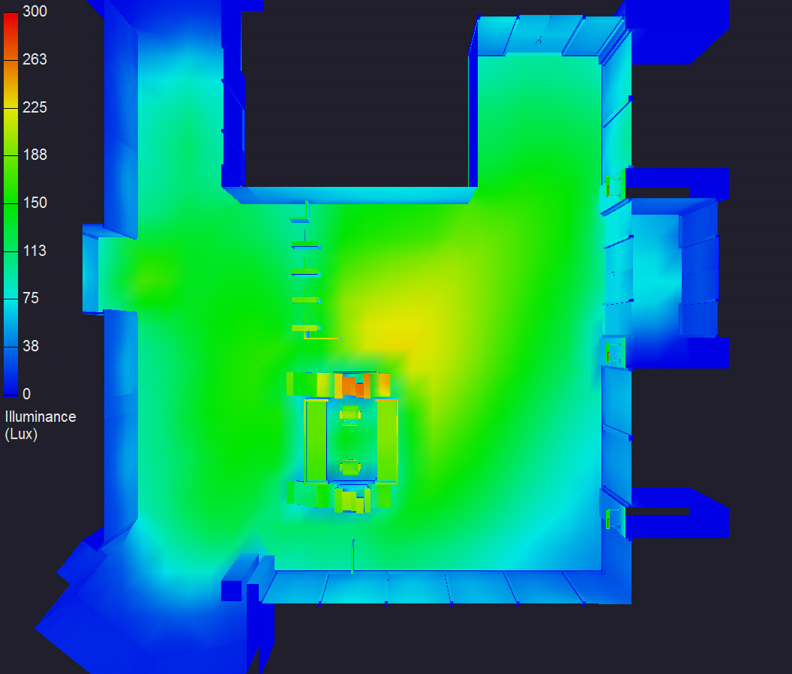
Introduction
Lighting Depth
Main Lobby
Introduction/Location
Design Criteria
Final Design
Design Analysis
Open Office
Ceremonial Courtroom
Electrical Depth
Mechanical Breadth
Acoustical Breadth and MAE Depth
Conclusion
Criteria Vs. Design
Illuminance
Location |  | Eh (lux) | Height Eh | Avg:Min
Security Screening | Target | 200 | 3’-0" | 2:1
 | Design | 186 | 3’-0" | 1.7:1
Lobbies near entries (day) | Target | 100 | Floor | 4:1
 | Design | 139 | Floor | 3.2:1
Power
 | W/SF | Percent Reduction
ASHRAE Maximum | 0.9 | 63%
Design | 0.33

Slide 13
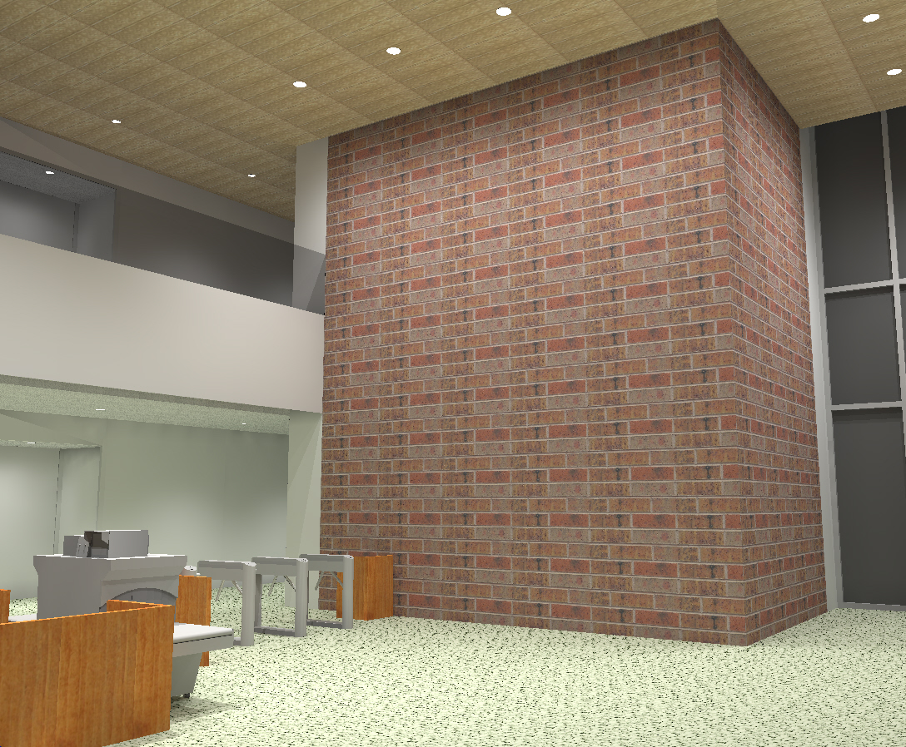
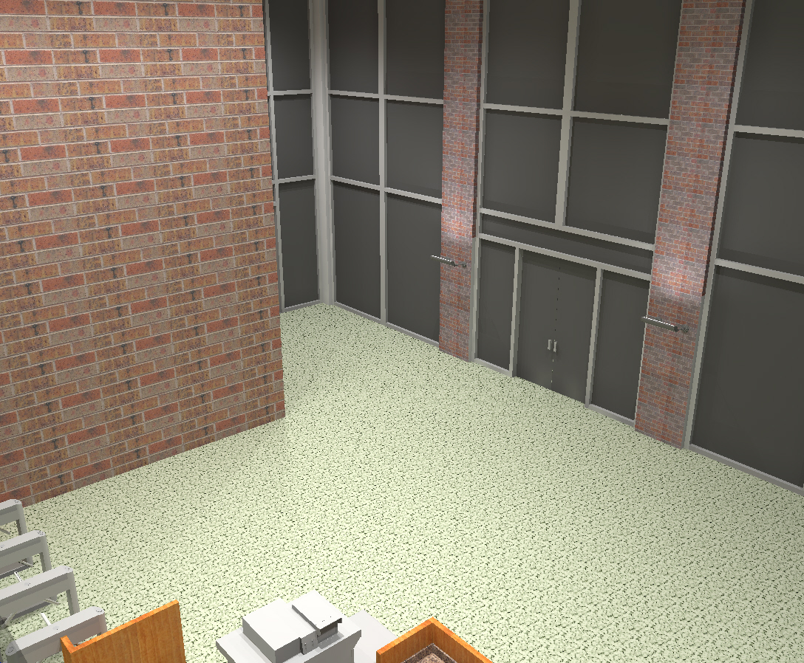
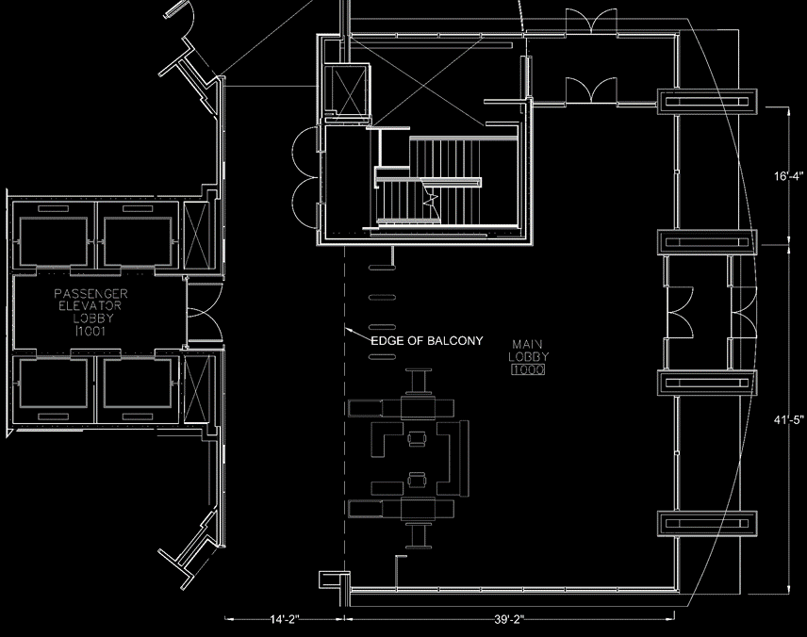

Introduction
Lighting Depth
Main Lobby
Introduction/Location
Design Criteria
Final Design
Design Analysis
Open Office
Ceremonial Courtroom
Electrical Depth
Mechanical Breadth
Acoustical Breadth and MAE Depth
Conclusion

Slide 14
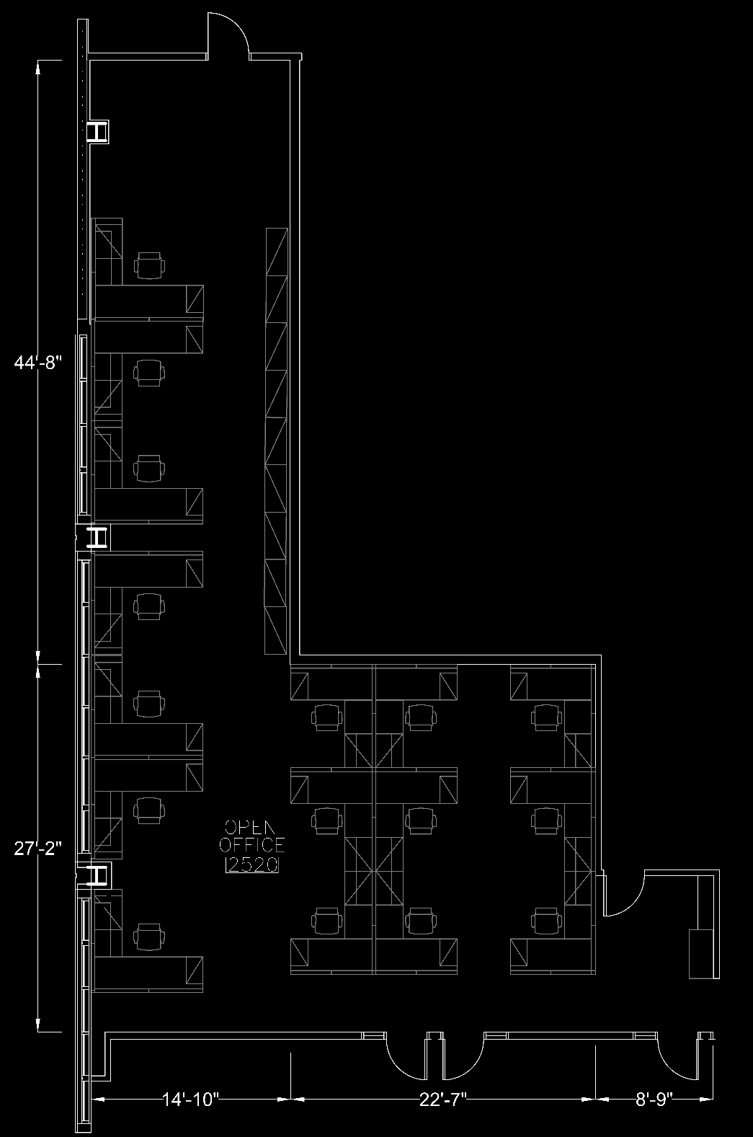
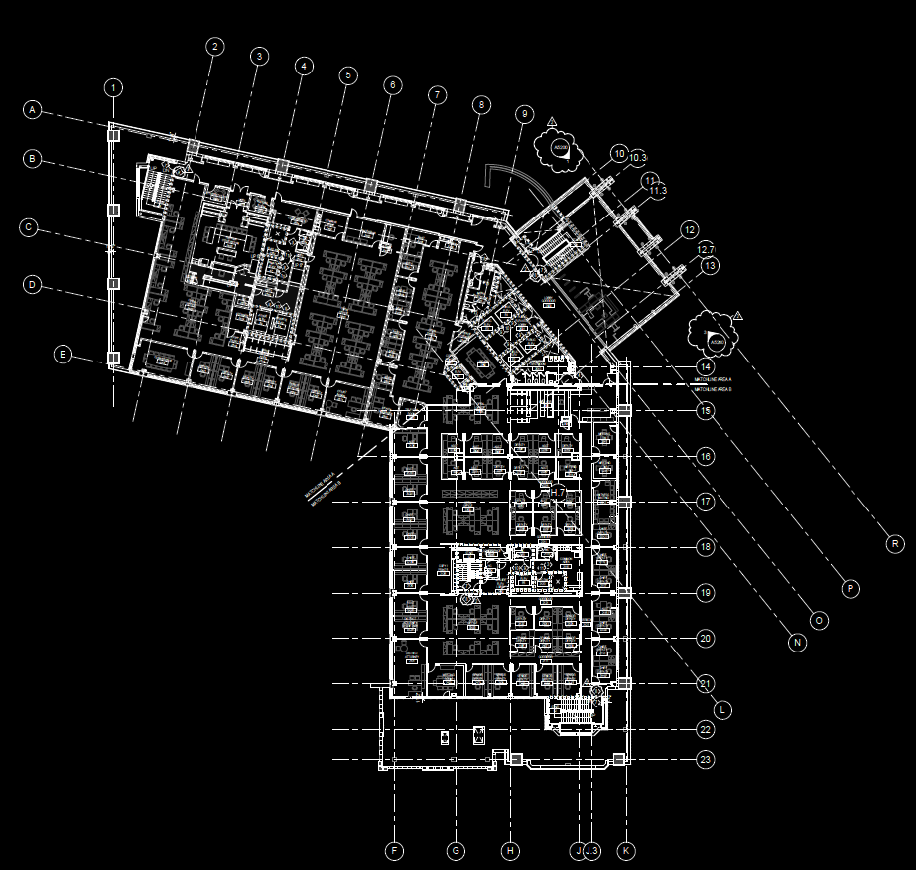
Introduction
Lighting Depth
Main Lobby
Open Office
Introduction/Location
Design Criteria
Final Design
Design Analysis
Ceremonial Courtroom
Electrical Depth
Mechanical Breadth
Acoustical Breadth and MAE Depth
Conclusion
Open Office 2520
Room Area: ~1,300 SF
Ceiling Height: 9’-0”
Half height partitions
N
N

Slide 15
Introduction
Lighting Depth
Main Lobby
Open Office
Introduction/Location
Design Criteria
Final Design
Design Analysis
Ceremonial Courtroom
Electrical Depth
Mechanical Breadth
Acoustical Breadth and MAE Depth
Conclusion
Quantitative Criteria
Qualitative Criteria
Openness
Promote community
Views
Location | Eh (lux) | Elevation Eh | Avg:Min
Open Office | 300 | 2’-6” | 1.5:1*
*From Table 12.6
LPD (W/SF) | Local Control | Manual ON | Restricted to Partial Automatic ON | Bilevel Lighting Control | Automatic Daylight Responsive Controls for Sidelighting | Automatic Full OFF | Scheduled Shutoff
0.98 | REQ | ADD1 | ADD1 | REQ | REQ | ADD2 | ADD2

Slide 16
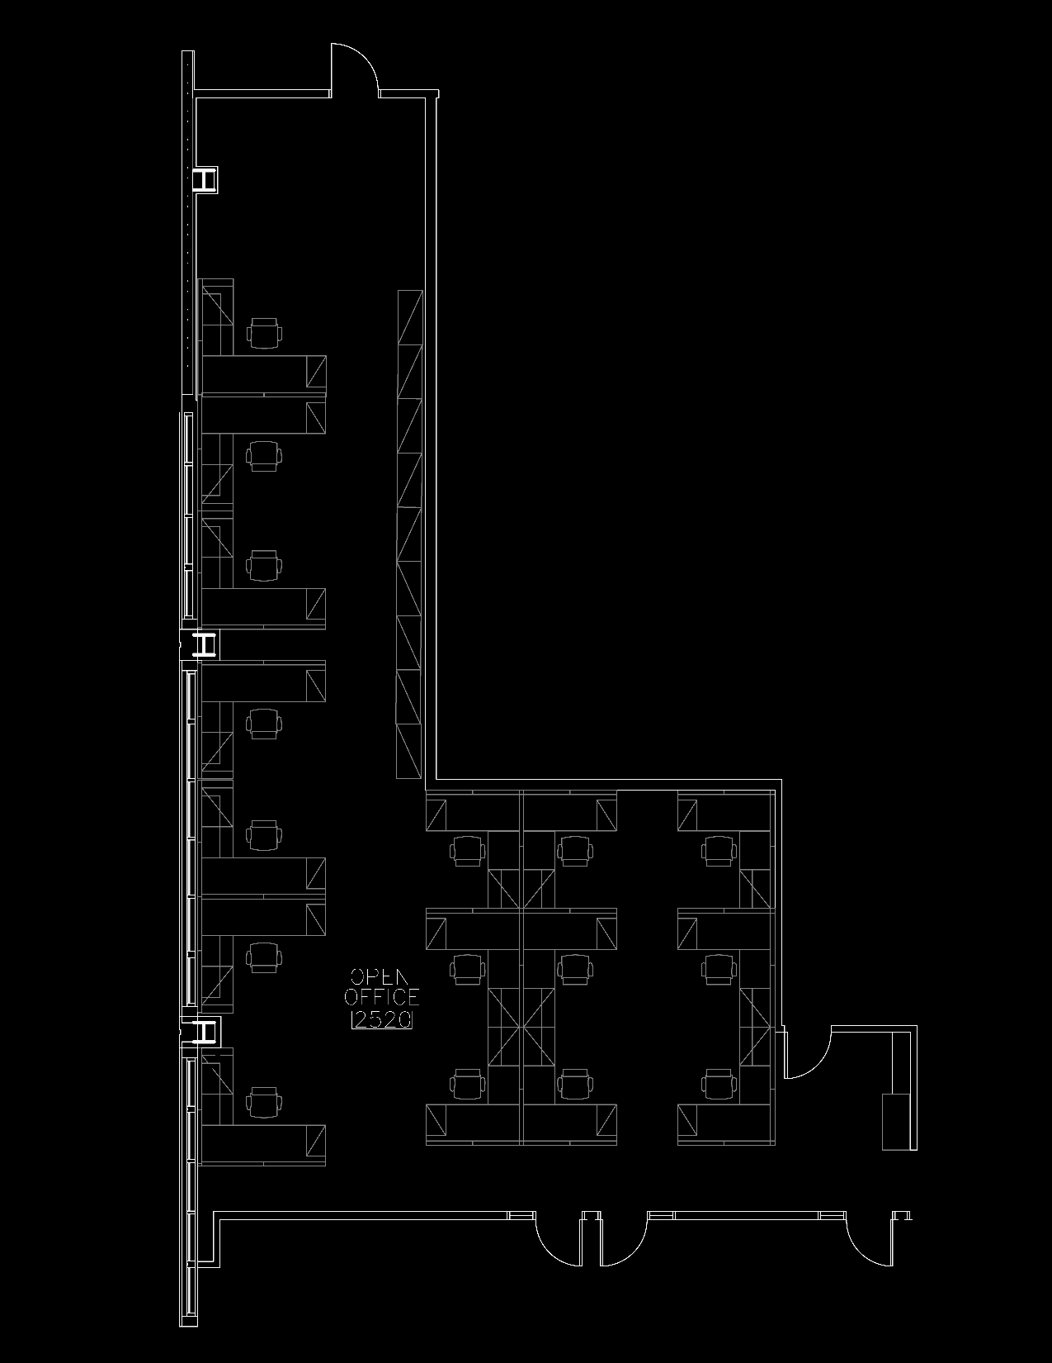
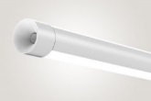

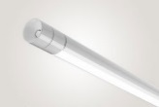
Introduction
Lighting Depth
Main Lobby
Open Office
Introduction/Location
Design Criteria
Final Design
Design Analysis
Ceremonial Courtroom
Electrical Depth
Mechanical Breadth
Acoustical Breadth and MAE Depth
Conclusion
P1E
P2
P1
P2
Type | Description | CCT (K) | CRI | Life (Hours) | Input (Watts) | Fixture Image
P1 | CYLINDRICAL LED DIRECT/INDIRECT PENDANT | 3500 | 80+ | 50,000 L80 | 40
P1E | EMERGENCY CYLINDRICAL LED DIRECT/INDIRECT PENDANT | 3500 | 80+ | 50,000 L80 | 40
P2 | CYLINDRICAL LED WALL WASHER PENDANT | 3500 | 80+ | 50,000 L80 | 20
P3 | CYLINDRICAL LED DIRECT/INDIRECT PENDANT | 3500 | 80+ | 50,000 L80 | 60
P2
P2
P1
P2
P1
P2
P2
P1
P2
P2
P1
P2
Luminaire Type P2 is suspended 8’-0” AFF
All others are suspended 7’-0” AFF
P1
P1
P1
P1
P1
P1E
P1
P1
P1
P1
P1
P1
P1
P1
P1
P1E
P3

Slide 17
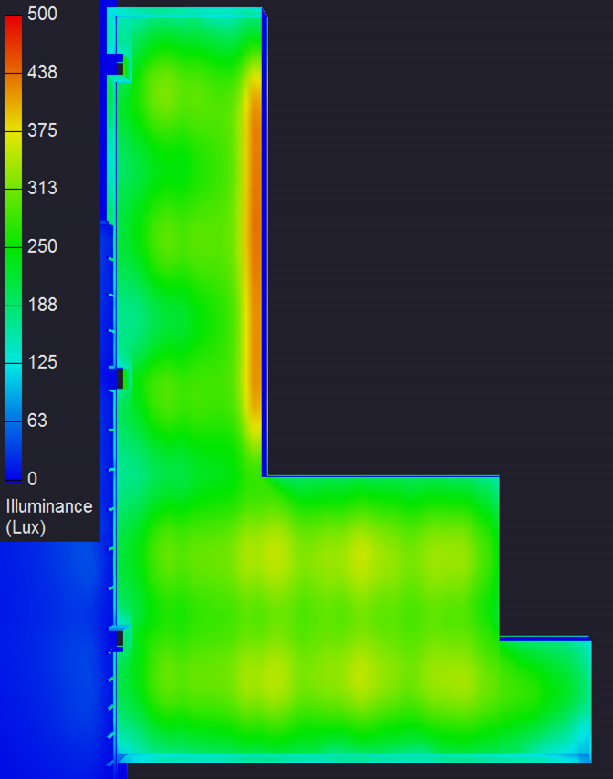
Introduction
Lighting Depth
Main Lobby
Open Office
Introduction/Location
Design Criteria
Final Design
Design Analysis
Ceremonial Courtroom
Electrical Depth
Mechanical Breadth
Acoustical Breadth and MAE Depth
Conclusion
Criteria Vs. Design
Illuminance
Location |  | Eh (lux) | Height Eh | Avg:Min
Open Office | Target | 300 | 2‘-6" | 1.5:1
 | Design | 329 | 2'-6" | 2.0:1
Power
 | W/SF | Percent Reduction
ASHRAE Maximum | 0.98 | 28%
Design | 0.71

Slide 18
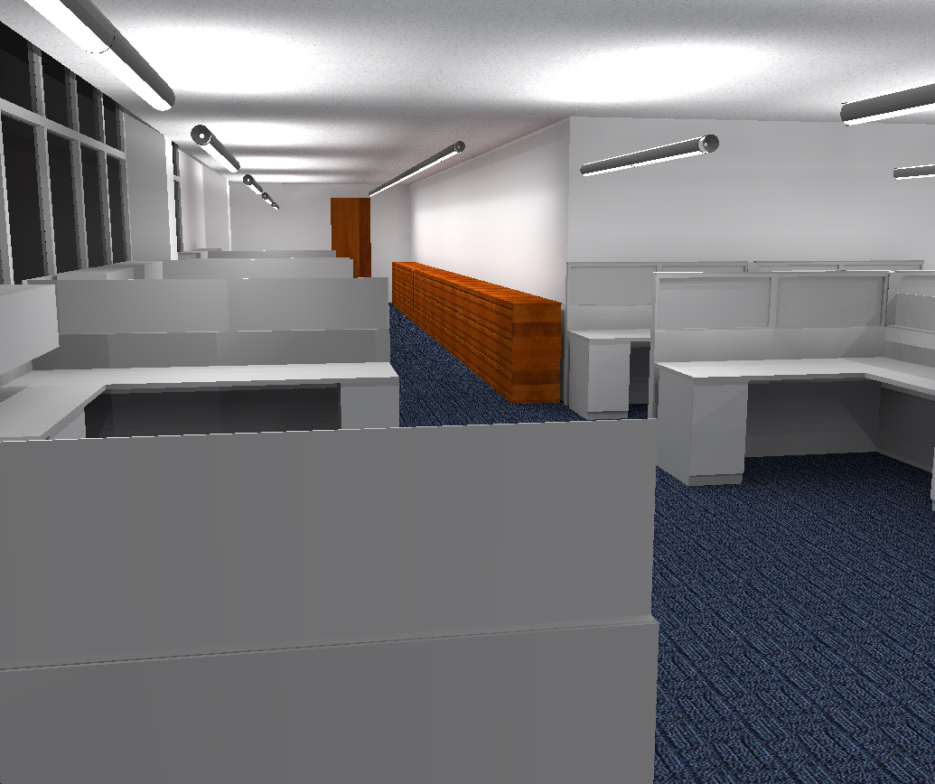
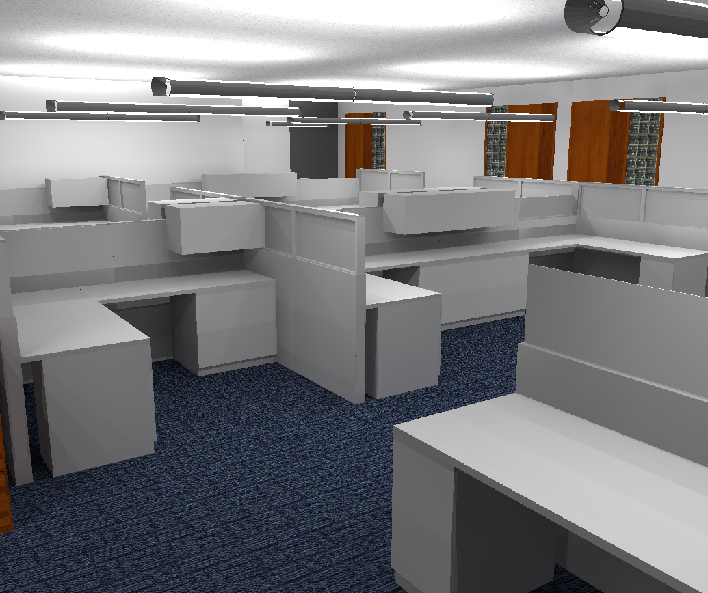
Introduction
Lighting Depth
Main Lobby
Open Office
Introduction/Location
Design Criteria
Final Design
Design Analysis
Ceremonial Courtroom
Electrical Depth
Mechanical Breadth
Acoustical Breadth and MAE Depth
Conclusion

Slide 19

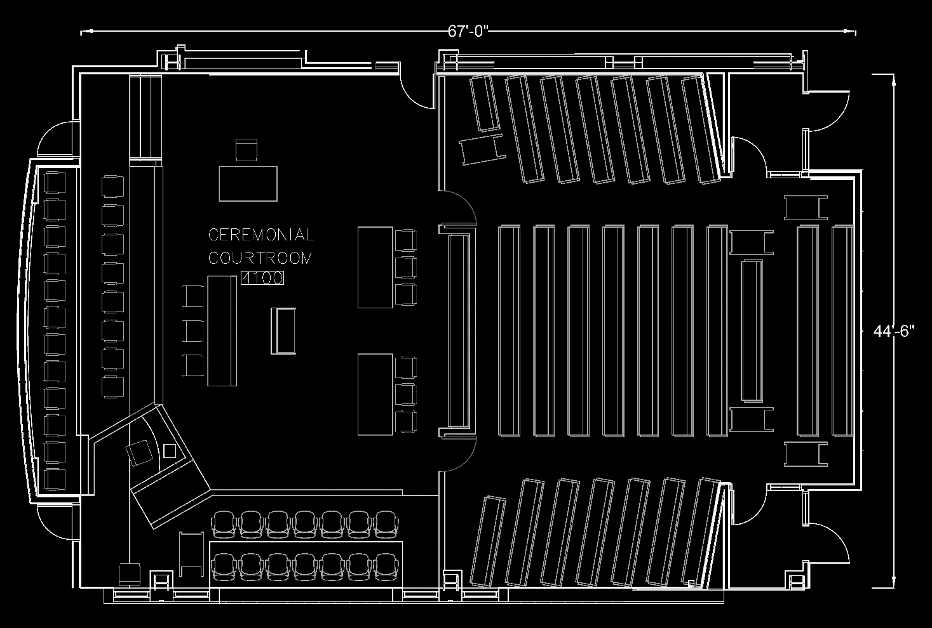
Introduction
Lighting Depth
Main Lobby
Open Office
Ceremonial Courtroom
Introduction/Location
Design Criteria
Final Design
Design Analysis
Electrical Depth
Mechanical Breadth
Acoustical Breadth and MAE Depth
Conclusion
Ceremonial Courtroom 4100
Room Area: ~2,900 SF
Ceiling Height: 10’-6”
Public Seating Capacity: 222
N
N

Slide 20
Introduction
Lighting Depth
Main Lobby
Open Office
Ceremonial Courtroom
Introduction/Location
Design Criteria
Final Design
Design Analysis
Electrical Depth
Mechanical Breadth
Acoustical Breadth and MAE Depth
Conclusion
Quantitative Criteria
Qualitative Criteria
Dignified
Flexibility
Location | Eh (lux) | Elevation Eh | Avg:Min
Attorneys’ Tables | 500 | 2’-6” | 2:1
Bench and Clerks | 500 | 2’-6” | 2:1
Jury Box | 300 | 2’-6” | 2:1
Witness Stand | 300 | 2’-6” | 2:1
Public Seating | 100 | 2’-6” | 2:1
Location | Ev (lux) | Max:Avg | Notes
AV Presentation Screen | 50 | 2:1 | Max Value
LPD (W/SF) | Local Control | Manual ON | Restricted to Partial Automatic ON | Bilevel Lighting Control | Automatic Daylight Responsive Controls for Sidelighting | Automatic Full OFF | Scheduled Shutoff
1.72 | REQ | ADD1 | ADD1 | REQ | REQ | ADD2 | ADD2

Slide 21
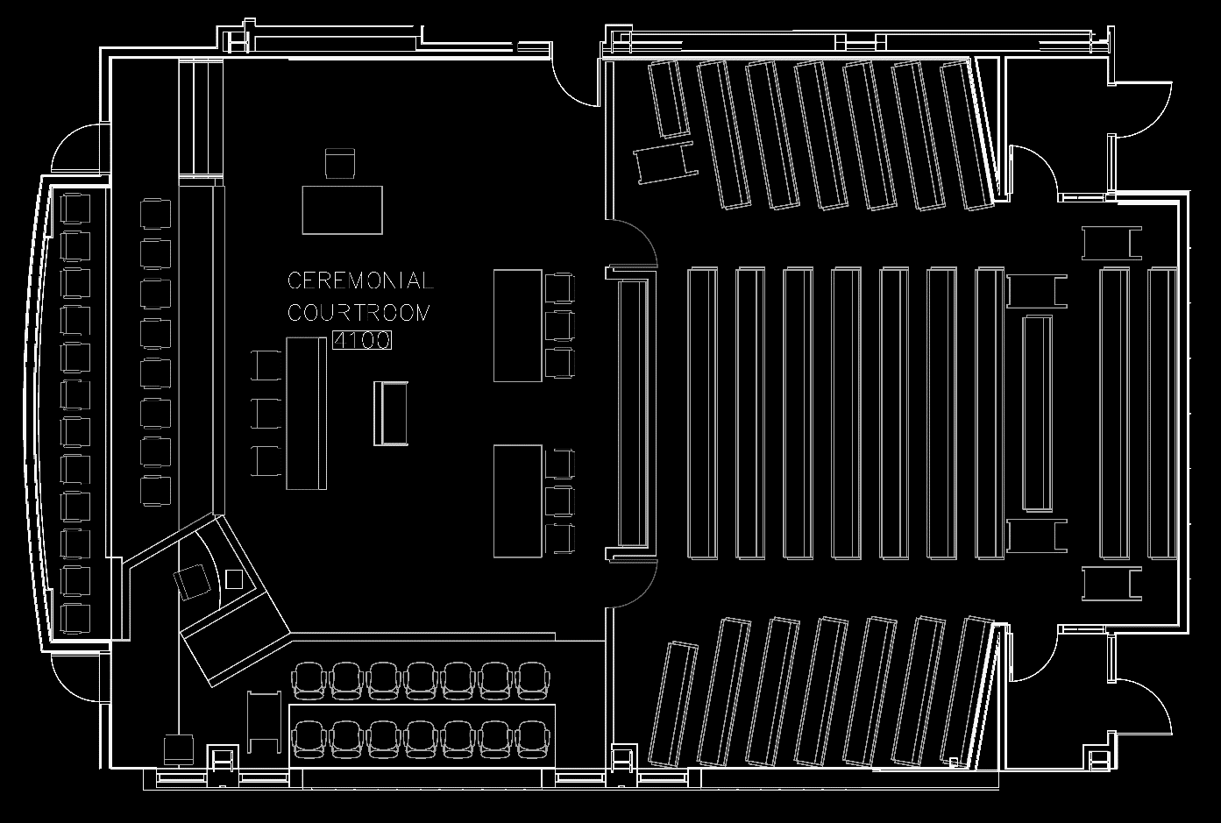
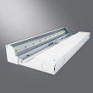
Introduction
Lighting Depth
Main Lobby
Open Office
Ceremonial Courtroom
Introduction/Location
Design Criteria
Final Design
Design Analysis
Electrical Depth
Mechanical Breadth
Acoustical Breadth and MAE Depth
Conclusion
Type | Description | CCT (K) | CRI | Life (Hours) | Input (Watts) | Fixture Image
R1 | RECESSED CIRCULAR 6 INCH NARROW BEAM DOWNLIGHT 1500 LUMEN | 3500 | 80 | 50,000 L70 | 22.4
R2 | RECESSED CIRCULAR 6 INCH WIDE BEAM DOWNLIGHT 1000 LUMEN | 3500 | 80 | 50,000 L70 | 14.1
R4 | RECESSED CIRCULAR 6 INCH WIDE BEAM WALL WASH 1000 LUMEN | 3500 | 80 | 50,000 L70 | 14.1
R10 | RECESSED CIRCULAR 6 INCH WIDE BEAM DOWNLIGHT 3000 LUMEN | 3500 | 80 | 50,000 L70 | 43.6
R11 | RECESSED CIRCULAR 6 INCH MEDIUM BEAM DOWNLIGHT 2000 LUMEN | 3500 | 80 | 50,000 L70 | 31.5
S1E | SURFACE MOUNTED LINEAR CEILING WASH | 3500 | 80+ | 50,000 L70 | 63.4
R2
R2
R2
R2
R2
R2
R11
S1E
R4
R10
R2
R2
R1
R2
R2
R4
R4
R10
R11
R1
R4
R1
R2
R2
R2
R2
R4
R10
R11
R1
R4
R4
R1
R2
R2
R11
R2
R2
S1E
R2
R2
R2
R2
R2
R2
R4
R4
R4
R4
R4
R4

Slide 22
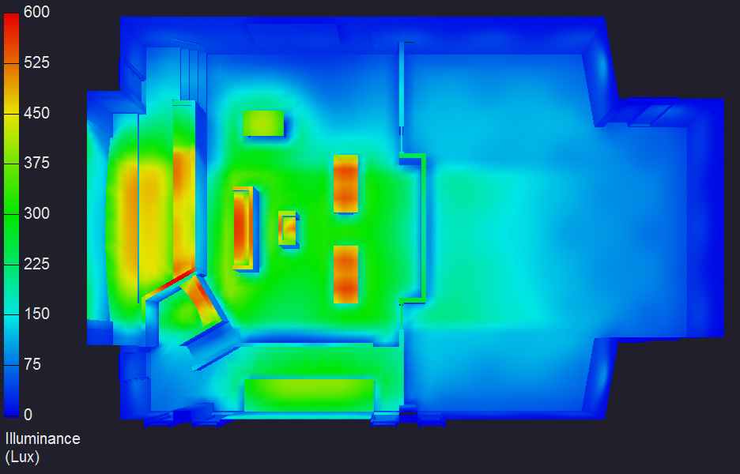
Introduction
Lighting Depth
Main Lobby
Open Office
Ceremonial Courtroom
Introduction/Location
Design Criteria
Final Design
Design Analysis
Electrical Depth
Mechanical Breadth
Acoustical Breadth and MAE Depth
Conclusion
Criteria Vs. Design
Illuminance
Location |  | Eh (lux) | Avg:Min
Attorney’s Tables | Target | 500 | 2:1
 | Table 1 | 454 | 1.1:1
 | Table 2 | 457 | 1.1:1
Bench and Clerks | Target | 500 | 2:1
 | Design (Bench Upper) | 434 | 1.9:1
 | Design (Bench Lower) | 460 | 1.7:1
 | Design (Clerks) | 500 | 1.2:1
Podium | Target | 500 | 2:1
 | Design | 456 | 1.1:1
Jury Box | Target | 300 | 2:1
 | Design | 325 | 2.0:1
Witness Stand | Target | 300 | 2:1
 | Design | 384 | 1.1:1
Public Seating | Target | 100 | 2:1
 | Design | 123 | 2.1:1
Power
 | W/SF | Percent Reduction
ASHRAE Maximum | 1.72 | 62%
Design | 0.66

Slide 23
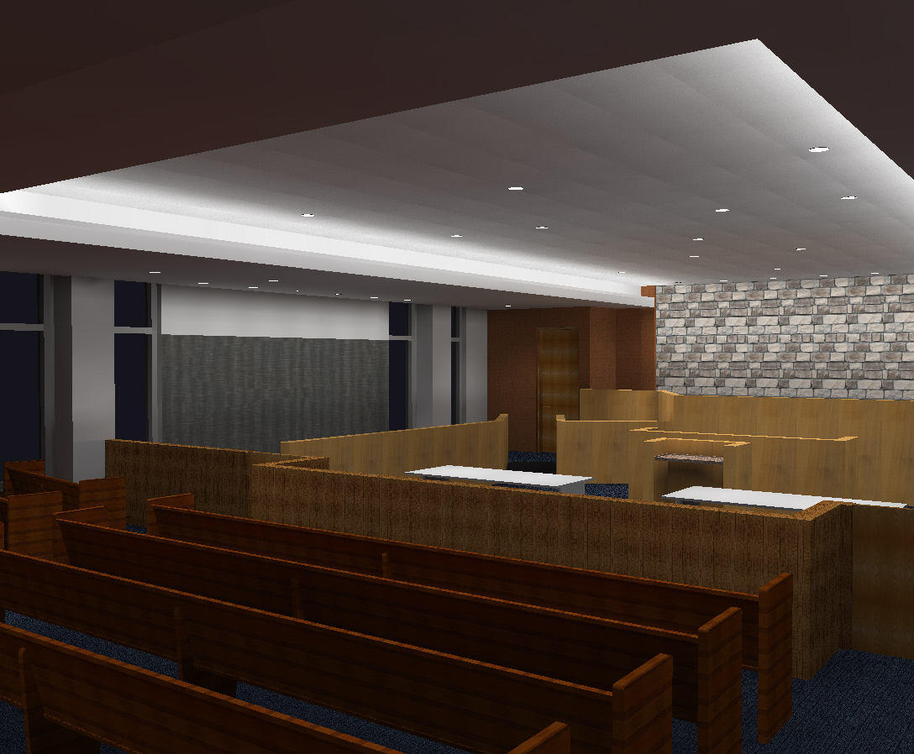
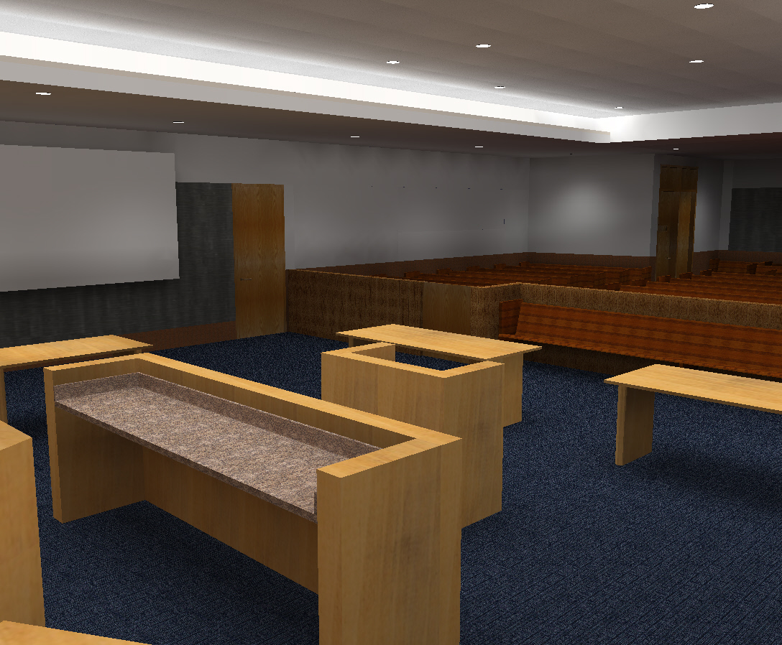
Introduction
Lighting Depth
Main Lobby
Open Office
Ceremonial Courtroom
Introduction/Location
Design Criteria
Final Design
Design Analysis
Electrical Depth
Mechanical Breadth
Acoustical Breadth and MAE Depth
Conclusion

Slide 24
Introduction
Lighting Depth
Electrical Depth
Introduction
Short Circuit Study
Mechanical Breadth
Acoustical Breadth and MAE Depth
Conclusion
Influence of Lighting Depth
Short Circuit Study
DC Efficiency Analysis

Slide 25
Introduction
Lighting Depth
Electrical Depth
Introduction
Short Circuit Study
Mechanical Breadth
Acoustical Breadth and MAE Depth
Conclusion
Transformer Max Let Through Current
Percentage Loss Due to Conductor Impedance

Slide 26
Introduction
Lighting Depth
Electrical Depth
Introduction
Short Circuit Study
Mechanical Breadth
Acoustical Breadth and MAE Depth
Conclusion
Short Circuit Current (Busway #2)
Conclusion
Branch circuit panels: AIC rating of 10,000 A
Devices on the primary side of the transformers:
AIC of 35,000 A or 50,000 A depending on the location

Slide 27
Introduction
Lighting Depth
Electrical Depth
Mechanical Breadth
Introduction
Analysis
Acoustical Breadth and MAE Depth
Conclusion
Combined Heat and Power (CHP) Feasibility Analysis
Advantages:
Increases primary fuel efficiency
Reduces emissions
Allows “off grid” operation
Data Sources
Thermal Demand was exported from a Trane Trace Model
Electric demand data was derived from EIA data for similar buildings
Natural gas and electric costs came from EIA average data for Pennsylvania

Slide 28
Introduction
Lighting Depth
Electrical Depth
Mechanical Breadth
Data Sources
Analysis
Acoustical Breadth and MAE Depth
Conclusion
Monthly Thermal and Electric Demand and Lambda D
Thermal and Electrical Base Loads
Summer Average (June, July, August)
Thermal (MMBTU/hr) | 1.99
Winter Average (December, January, February)
Electric (KW) | 590
Results
λ_{D} Annual
1.34
Spark Spread
21.98
Simple Payback
16.3 Years

Slide 29

Introduction
Lighting Depth
Electrical Depth
Mechanical Breadth
Acoustical Breadth and MAE Depth
Introduction
Acoustical Breadth (RT Analysis)
MAE Depth (Audio Amplification System Analysis)
Conclusion
Speech Intelligibility of Ceremonial Courtroom 4100
Performed a reverberation time (RT) analysis
Analyzed the influence of the audio reinforcement system

Slide 30
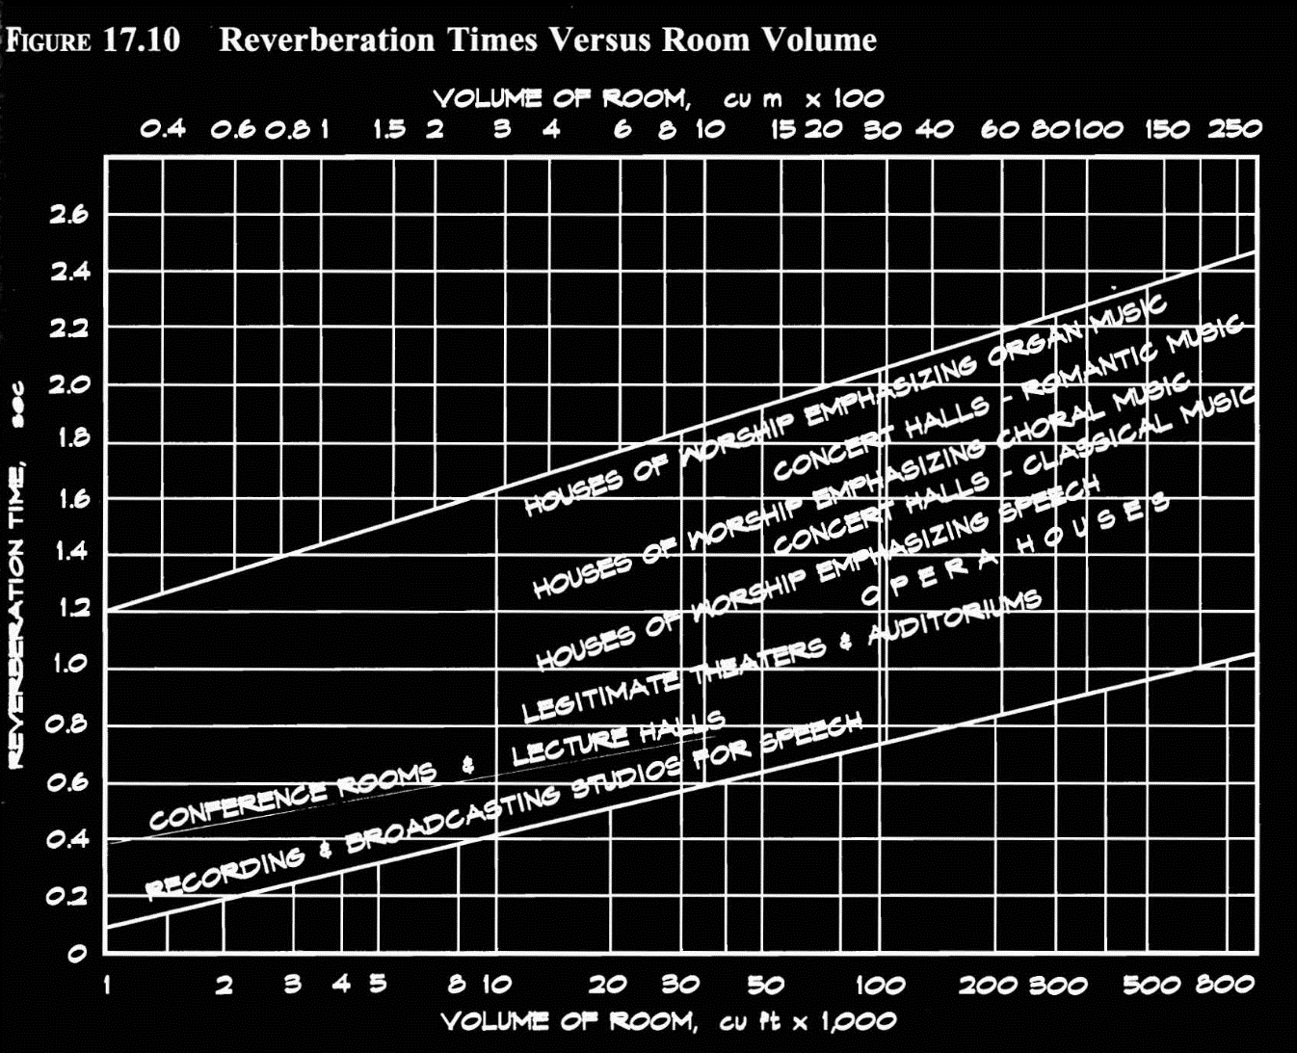
Introduction
Lighting Depth
Electrical Depth
Mechanical Breadth
Acoustical Breadth and MAE Depth
Introduction
Acoustical Breadth (RT Analysis)
MAE Depth (Audio Amplification System Analysis)
Conclusion
Design Criteria
Results
Figure 17.10 from “Architectural Acoustics” by Marshall Long

Slide 31
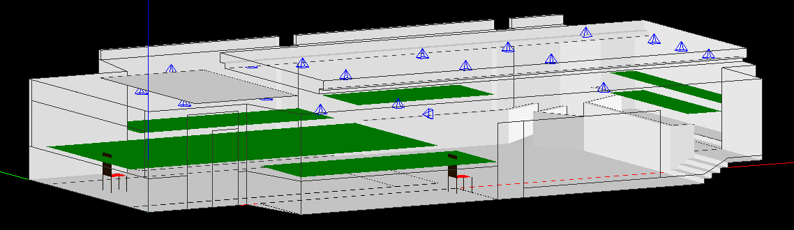
Introduction
Lighting Depth
Electrical Depth
Mechanical Breadth
Acoustical Breadth and MAE Depth
Introduction
Acoustical Breadth (RT Analysis)
MAE Depth (Audio Amplification System Analysis)
Conclusion
Speaker (Typ.)
Audience 1
Seat 2
Human Source
Judges 2
Judges 1
Audience 2
Seat 1
Jury
Audience 3

Slide 32
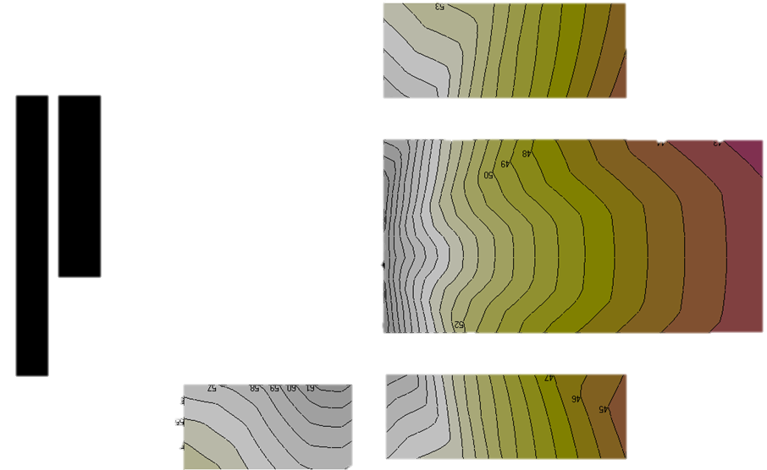
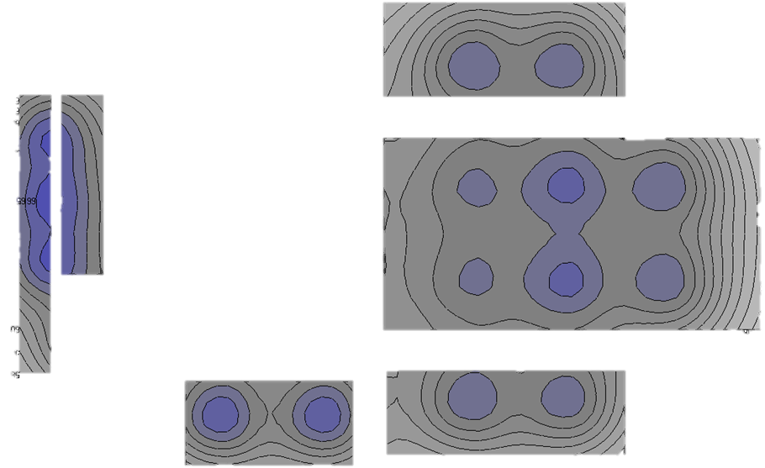
Introduction
Lighting Depth
Electrical Depth
Mechanical Breadth
Acoustical Breadth and MAE Depth
Introduction
Acoustical Breadth (RT Analysis)
MAE Depth (Audio Amplification System Analysis)
Conclusion
SPL Plot Without Reinforcement
SPL Plot With Reinforcement

Slide 33

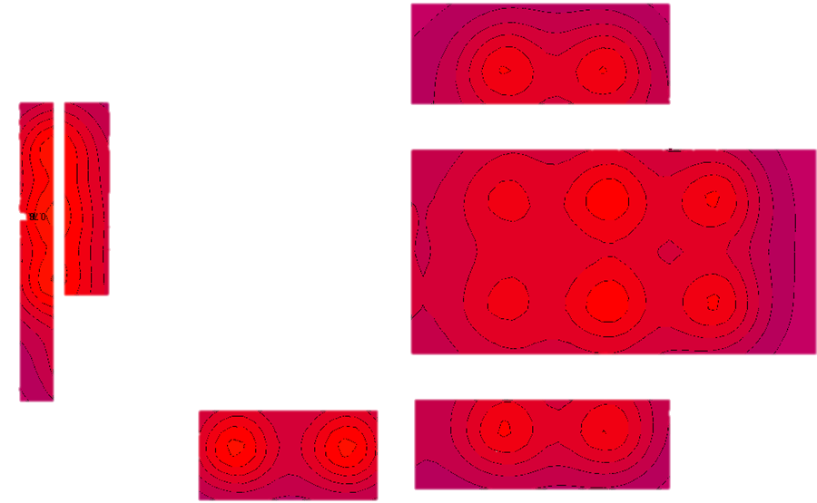

Introduction
Lighting Depth
Electrical Depth
Mechanical Breadth
Acoustical Breadth and MAE Depth
Introduction
Acoustical Breadth (RT Analysis)
MAE Depth (Audio Amplification System Analysis)
Conclusion
STI Plot Without Reinforcement
STI Plot With Reinforcement

Slide 34

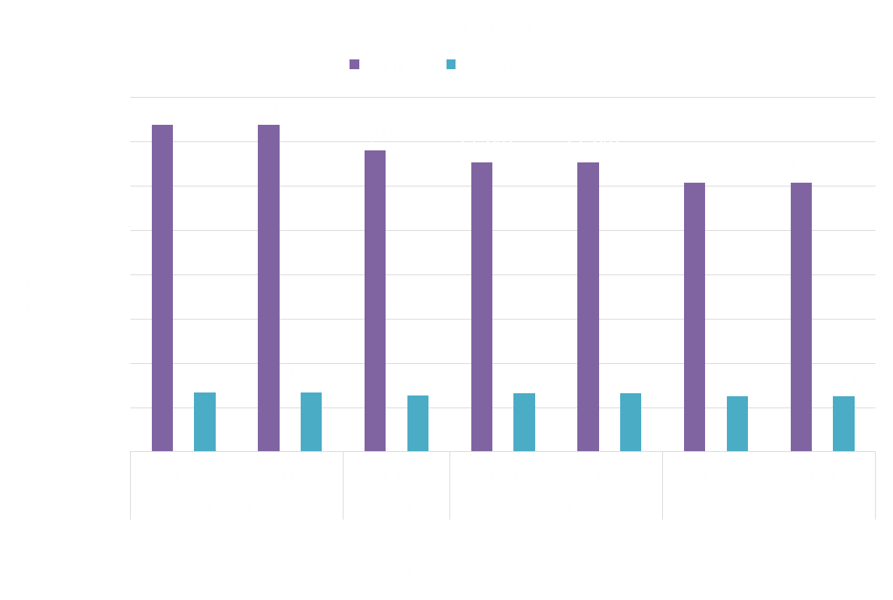
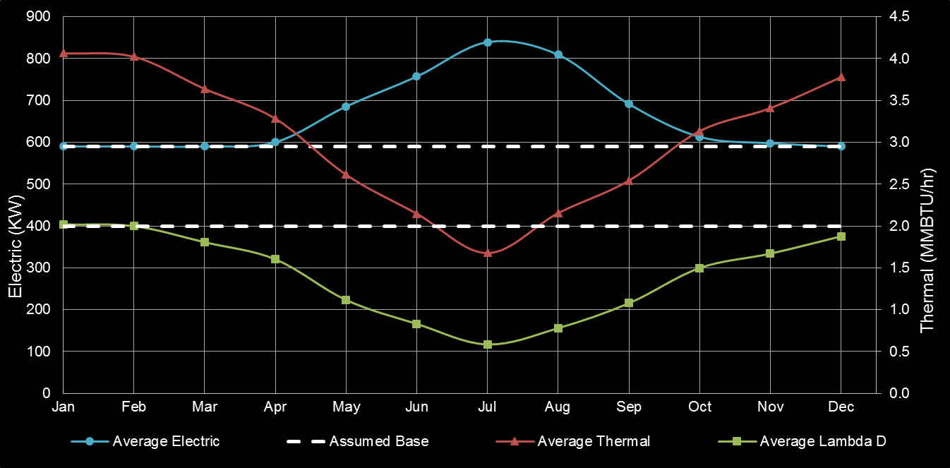
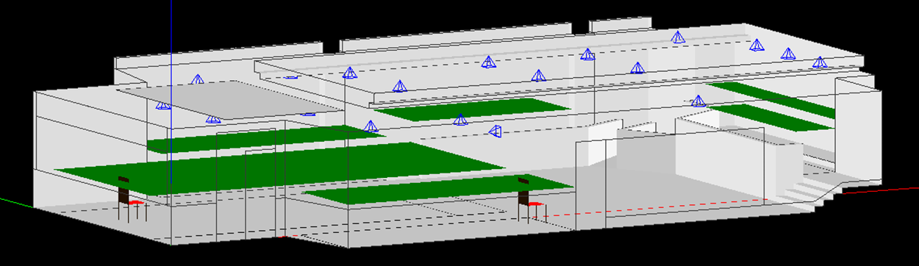
Introduction
Lighting Depth
Electrical Depth
Mechanical Breadth
Acoustical Breadth and MAE Depth
Conclusion
Summary
Acknowledgements
Lighting Depth
Electrical Depth
Mechanical Breadth
Acoustical Breadth/MAE Depth

Slide 35
Introduction
Lighting Depth
Electrical Depth
Mechanical Breadth
Acoustical Breadth and MAE Depth
Conclusion
Summary
Acknowledgements
Acknowledgements
Mr. Gerald Anderson
Mr. Scott Mack and the team at H.F. Lenz
Dr. Richard Mistrick
Mr. Gary Golaszewski
Dr. Michelle Vigeant
Dr. James Freihaut

Slide 36
Introduction
Lighting Depth
Electrical Depth
Mechanical Breadth
Acoustical Breadth and MAE Depth
Conclusion
Senior Thesis Presentation
Bucks County Justice Center
Doylestown, PA
Joshua Lange
Lighting/Electrical
Thesis Adviser: Dr. Richard Mistrick
Electrical Adviser: Gary Golaszewski
4/15/2015

Slide 37
Main Lobby 1000

Slide 38
Open Office 2520

Slide 39
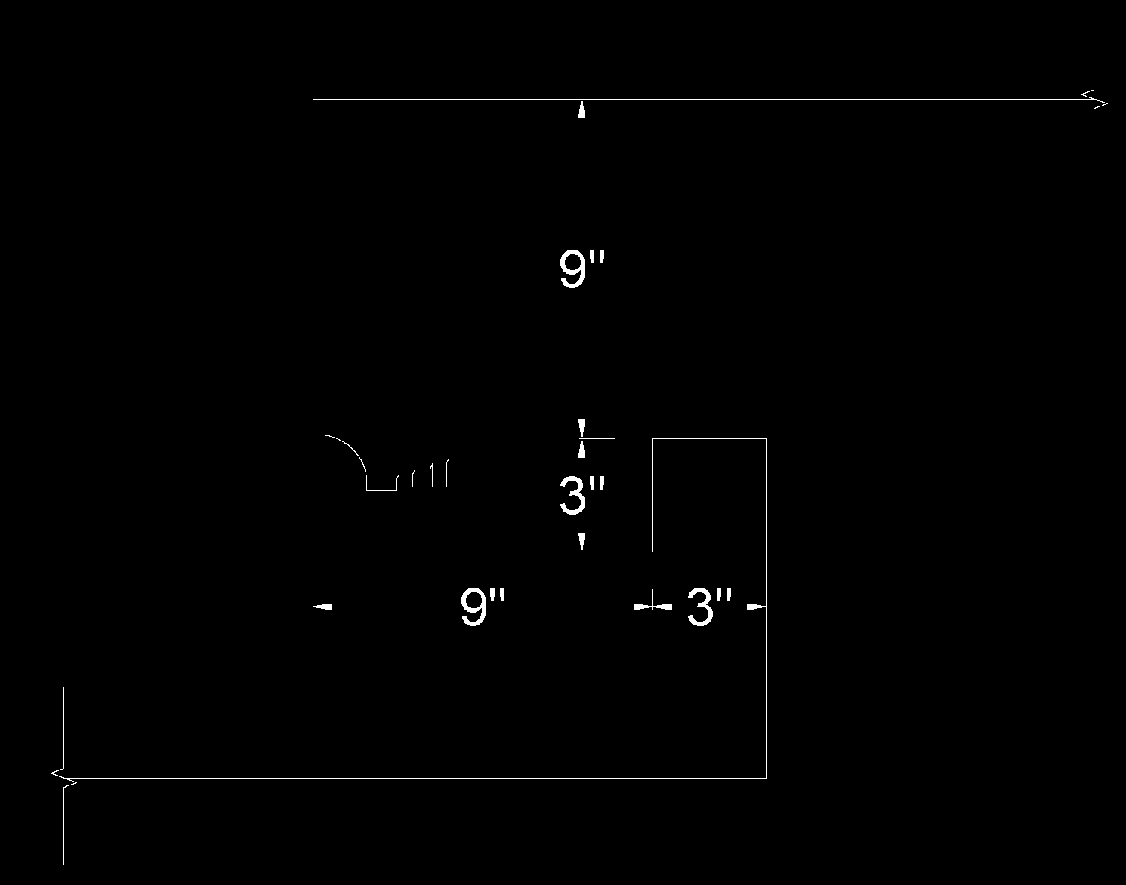
Ceremonial Courtroom 4100
Space | Fixture | Quantity | Watts per fixture | Total watts | Room Area | LPD (W/SF) | Space Type | Allowed LPD | Allowed Watts
Ceremonial Courtroom 4100 |  |  |  | 1905 | 2900 | 0.66 | Courtroom | 1.72 | 4988
 | R1 | 5 | 22.4 | 112
 | R2 | 24 | 14.1 | 338.4
 | R4 | 13 | 14.1 | 183.3
 | R10 | 3 | 43.6 | 130.8
 | R11 | 4 | 31.5 | 126
 | S1 | 16 | 63.4 | 1014

Slide 40





Short Circuit Study
Designation | KVA | Primary Voltage | Secondary Voltage | Phase | Type | %Z* | Mounting | I _{FLA} | I_{SC}
T1 | 2000 | 34,500 | 480Y/277 | 3 | Dry | 5.75 | Floor | 7,217 | 125,511
T2 | 30 | 480 | 208Y/120 | 3 | Dry | 1.8 | Hung | 250 | 13,879
T4 | 45 | 480 | 208Y/120 | 3 | Dry | 1.8 | Hung | 375 | 20,818
T29 | 15 | 480 | 208Y/120 | 3 | Dry | 1.9 | Hung | 125 | 6,574
T31 | 75 | 480 | 208Y/120 | 3 | Dry | 1.7 | Hung | 625 | 36,738
Location | Conductor Type | Length (Feet) | Table 5 C | I_{3∅} | Conductors per phase (n) | V_{LL} | f 3∅ Faults | M | I_{SC} | Notes
Bus #2 Feed | 3 Sets 300 KCMIL | 30 | 18177 | 125,511 | 3 | 480 | 0.25 | 0.80 | 100,476 | Approximate length of conductor from main panel to bus
Level 6 | 800A Bus | 16 | 49300 | 100,476 | 1 | 480 | 0.12 | 0.89 | 89,898 | Length of bus to electrical room based on floor to floor height
Level 5 | 800A Bus | 32 | 49300 | 100,476 | 1 | 480 | 0.24 | 0.81 | 81,335
Level 4 | 800A Bus | 48 | 49300 | 100,476 | 1 | 480 | 0.35 | 0.74 | 74,262
Level 3 | 800A Bus | 64 | 49300 | 100,476 | 1 | 480 | 0.47 | 0.68 | 68,320
Level 2 | 800A Bus | 80 | 49300 | 100,476 | 1 | 480 | 0.59 | 0.63 | 63,259
Level 1 | 800A Bus | 96 | 49300 | 100,476 | 1 | 480 | 0.71 | 0.59 | 58,896
$$I_{FLA}=\frac{\left(kVA\right)\left(1000\right)}{\left(V_{LL}\right)\sqrt{3}}$$
$$I_{SC}=\left(I_{FLA}\right)\left(\frac{100}{\%Z}\right)$$
$$I_{SC Secondary}=\frac{V_{primary}}{V_{secondary}}\left(M\right)\left(I_{SC Primary}\right)$$
$$3∅ faults:f=\frac{\sqrt{3}\left(L\right)\left(I_{3∅}\right)}{\left(C\right)\left(n\right)\left(V_{LL}\right)}$$
$$M=\frac{1}{1+f}$$

